Slide 1
CSSE 332 Critical Section Implementation
Thursday, April 9, 2020

Slide 2
Outline
Problem Review
Solutions
What we tried: disable interruption, global flag
What’s new:
Software-approach: Peterson’s algorithm
Hardware-supported approach: TestAndSet
Improving performance
Materials:
http://www.cs.cornell.edu/courses/cs4410/2015su/lectures/lec06-spin.html
http://pages.cs.wisc.edu/~remzi/OSTEP/threads-locks.pdf
https://en.wikipedia.org/wiki/Peterson%27s_algorithm

Slide 3
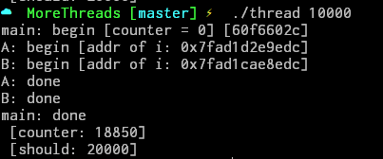
Problem Review
Two threads add (i++) 10000 times to a global variable (i.e., i). The result is less than 10000*2.

Slide 4
Review: Problem investigation
mov 0x8049a1c, %eax //1. load i
add $0x1, %eax //2. add one
mov %eax, 0x8049a1c //3. store new value
i = i + 1 →
If ..
Thread 1
Thread 2
mov 0x8049a1c, %eax
add $0x1, %eax
mov %eax, 0x8049a1c
mov 0x8049a1c, %eax
add $0x1, %eax
mov %eax, 0x8049a1c

Slide 5
Solution: The Wish For Atomicity
Goal: finish code in a critical section as a unit – no interrupt.
Correctness
Performance

Slide 6


Review: Approach #1
Disable/enable alarm
1 void lock() {
2 DisableInterrupts();
3 }
4 void unlock() {
5 EnableInterrupts();
6 }
But dangerous that any program may monopolize the CPU.
Correct
Performance

Slide 7

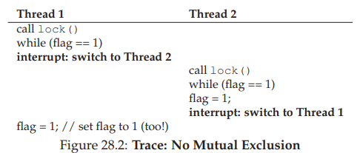
Review: Approach #2
Correct
Performance
Use a global flag
flag = 0; void lock() { while(flag == 1){ ;// do nothing } flag = 1; } void unlock() { flag = 0; }

Slide 8
Approach #3: Peterson’s algorithm
Assume there are two processes (P0, P1) wanting to enter the critical section. They share the following variables.
bool flag[2] = {false, false}; int turn;
P0: flag[0] = true;
turn = 1; while (flag[1] == true && turn == 1) { // busy wait } // critical section ... // end of critical section flag[0] = false;
P1: flag[1] = true; turn = 0; while (flag[0] == true && turn == 0) { // busy wait } // critical section ... // end of critical section flag[1] = false;
Let’s find bugs:
When are P0 and P1 both in the critical section?

Slide 9
Peterson’s algorithm (cont.)
Let’s find bugs:
When are P0 and P1 both in the critical section?
bool flag[2] = {false, false}; int turn;
P0: flag[0] = true;
turn = 1; while (flag[1] == true && turn == 1) { // busy wait } // critical section ... // end of critical section flag[0] = false;
P1: flag[1] = true; turn = 0; while (flag[0] == true && turn == 0) { // busy wait } // critical section ... // end of critical section flag[1] = false;
Can we just use turn?

Slide 10
Peterson’s algorithm (cont.)
No bugs (in theory):
If both processes are in their critical sections then we conclude that the state must satisfy flag[0] and flag[1] and turn = 0 and turn = 1. No state can satisfy both turn = 0 and turn = 1, so there can be no state where both processes are in their critical sections.
But problem on modern computer, because
mov 0x8049a1c, %eax //load data
Even this command is not a atomic operation due to the multiple cache on multiple CPU.

Slide 11
Approach #4: TestAndSet
Use atomic function which is supported by hardware
Now let’s write init(), lock() and unlock() functions with TestAndSet (TAS), so a critical section can be protected between lock() and unlock()
1 int TestAndSet(int *old_ptr, int new) { 2 int old = *old_ptr; // fetch old value at old_ptr 3 *old_ptr = new; // store ’new’ into old_ptr 4 return old; // return the old value 5 }
Return the old value and set the new value.

Slide 12
Make a spin-lock with TAS
1 typedef struct _lock_t { 2 int flag; 3 } lock_t; 4 5 void init(lock_t *lock) { 6 // 0 indicates that lock is available, 1 that it is held 7 lock->flag = 0; 8 } 9 10 void lock(lock_t *lock) { 11 while (TestAndSet(&lock->flag, 1) == 1) 12 ; // spin-wait (do nothing) 13 } 14 15 void unlock(lock_t *lock) { 16 lock->flag = 0; 17 }
Correct
Performance

Slide 13
Performance Improvement
Too Much Spinning: What Now?
A Simple Approach: Just Yield, Baby
Problem?
Not fair: It is indeterministic who can enter the critical section if many compete for.
void lock() { while(flag == 1){ yield();// give up the CPU } flag = 1; }

Slide 14
Performance Solution
Using Queues: Sleeping Instead Of Spinning
flag = 0; void lock() { while(flag == 1){ enqueue(); // put into a queue to wait } flag = 1; } void unlock() {
dequeue();// remove the process at the head of the queue and run it. flag = 0; }

